Slide 1

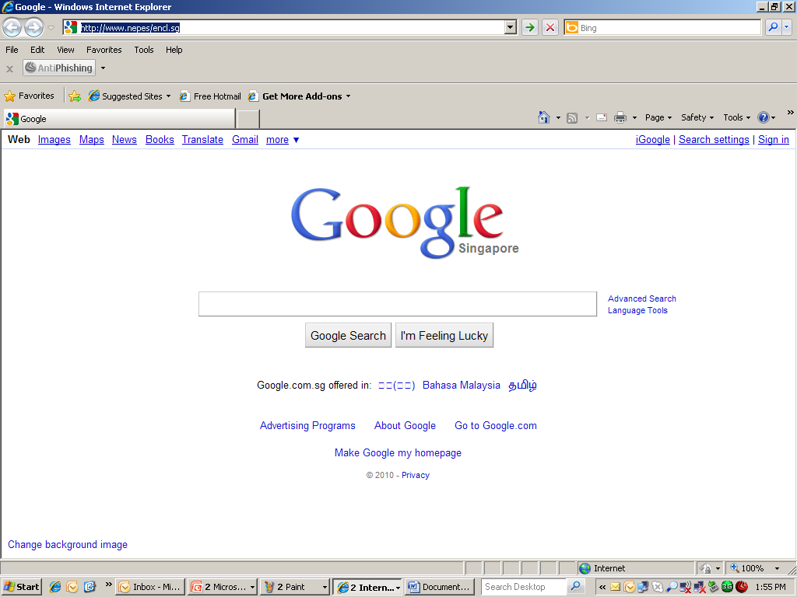









These data are system generated & gets picked up automatically. Need further enhancement.
(Eg. Sputter process, start with SPNCL-YYMM-XXXX)
Abnormality Report
NCL No.
Date of Issue
Status
115BN462A
2010-12-09 10:50:55
In Process
Title
*
Detection Date
*
Detection At
Select Area
*
Nepes Run No.
*
Device ID
Select Device ID
*
It can parallel route to different teams for similar approvals
Customer Lot ID
*
Defective Wafer
Quantity
*
Wafer Lot
Submitted By
Lawrence Lim
Select All
1 2 3 4 5 6 7 8 9 10 11 12 13 14 15 16 17 18 19 20 21 22 23 24 25
Lot Type
Select Production / Engineering
Category
Man
Method
Material
Machine
Environment
1. Abnormality Report Description
Lot Disposition
Wafer Image Viewer
Upload, documents, Pictures ..Etc
Use-As-Is
Rework
Scrap
Hold for Customer Disposition
BROWSE
MRB Review
The disposition will be judge by process engineering team and to determine the case belongs to which category.
MRB Review have to include and provide reasons on the selected Lot Disposition result.
A requestor submits the form by filling in the details.
Submit

Slide 2


Abnormality Report
NCL No.
Date of Issue
Status
115BN462A
2010-12-09 10:50:55
In Process
2. Corrective Action (s)
Upload, documents, Pictures ..Etc
BROWSE
3. Preventive Action (s)
Upload, documents, Pictures ..Etc
BROWSE
Submit
Action Manager Comments
Reject
Quality Manager Comments
Accept
Closure / QC Verification

Slide 3
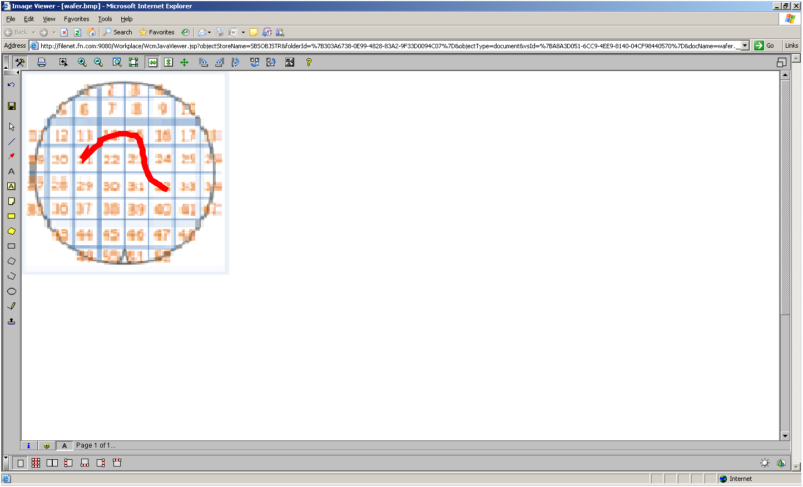

Close Image

Slide 4



Abnormality Report
NCL No.
Date of Issue
Status
115BN462A
2010-12-09 10:50:55
In Process
Title
*
Detection Date
*
Detection At
Select Area
*
Nepes Run No.
*
Device ID
Select Device ID
*
Customer Lot ID
*
Defective Wafer
Quantity
*
Wafer Lot
Submitted By
Lawrence Lim
Select All
Sample of Final E-NCL Report Format
1 2 3 4 5 6 7 8 9 10 11 12 13 14 15 16 17 18 19 20 21 22 23 24 25
Lot Type
Select Production / Engineering
Category
Man
Method
Material
Machine
Environment
1. Abnormality Report Description
Lot Disposition
Upload, documents, Pictures ..Etc
Use-As-Is
Rework
Scrap
Hold for Customer Disposition
BROWSE
MRB Review
Wafer Image Viewer
2. Corrective Action (s)
3. Preventive Action (s)
Closure / QC Verification
Any attachment Report

Slide 5


